Slide 1
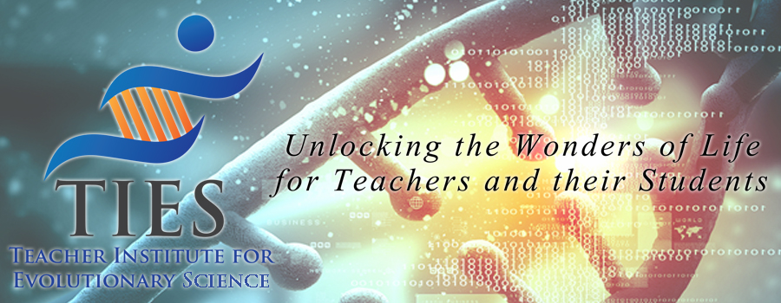
Evolution
It’s a Family Affair
Notes:
This presentation is editable so feel free to tailor it to your classroom. It can be found at https://richarddawkins.net/ties/ with many other classroom resources. There are several active learning activities under the slides that teachers can incorporate into this presentation. Also, there are many live links to videos and webpages embedded in the presentation. The teacher can make the presentation as long or as short as needed. The presentation can be presented over several days, stopping to present the hands-on, active learning activities along the way. Please contact Bertha Vazquez at bvazquez@centerforinquiry.org with questions or comments. TIES is here to help!

Slide 2

Diversity and Evolution Of Living Organisms
The scientific theory of evolution is the organizing
principle of life science.
2. The scientific theory of evolution is supported
by multiple forms of evidence.
3.Natural selection is the primary mechanism
leading to change over time in organisms.
Notes:
Yes! Evolution explained by Natural Selection is what makes biology make sense. Darwin’s idea unified life science. The evidence found in both the laboratory and in the field makes biology a fascinating subject showing our students how connected all life is with nature.

Slide 3
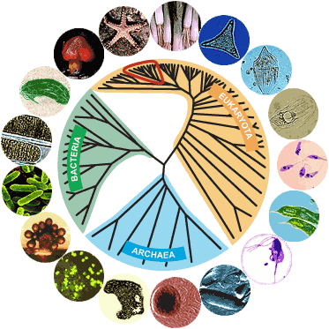
Standard I: The scientific theory of evolution is the organizing principle of life science.
What does Evolution claim?
The millions of different species of plants, animals, and microorganisms that live on earth today are all related by descent from common ancestors.
What is the result of Evolution?
The great diversity of organisms is the result of more than 3.5 billion years of evolution that has filled every available niche with life forms.
Earth's timeline
Notes:
Through the tree of life, all organisms can be traced to common ancestors through time. Selective pressures have resulted in a vast array of life forms, many extinct today, but a world of great diversity of life forms. The link to the timeline shows step by step how the biosphere (environment) has changed over billions of years. These changes in the environment have led to more complex and adapted organisms, that have in turn modified the environment allowing for again more diversity and changes to species. Click and drag the red triangle on the timeline to observe the changes on our planet Earth in the last 13 billion years! Students can create their own Earth’s timeline on cashier's tape, posters, or even their own arms!

Slide 4
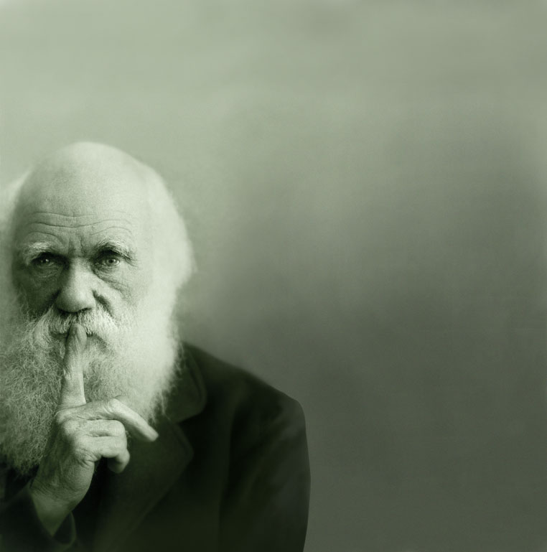
The concepts of common descent and natural selection were first proposed by Charles Darwin in his famous book, The Origin of Species in 1859
Who Was Charles Darwin?
Notes:
Darwin worked many years on his book The Origins of Species, before publishing it. He knew that his idea was revolutionary, yet accurate. As the short video shows in the link, “Who Was Charles Darwin,” Darwin’s theory of evolution through natural selection is what allows biology to “make sense.” Students can research other important scientists in evolutionary biology. E-mail us at bvazquez@centerforinquiry.net for a comprehensive list developed by TIES Teacher Corps Member, John Mead.

Slide 5
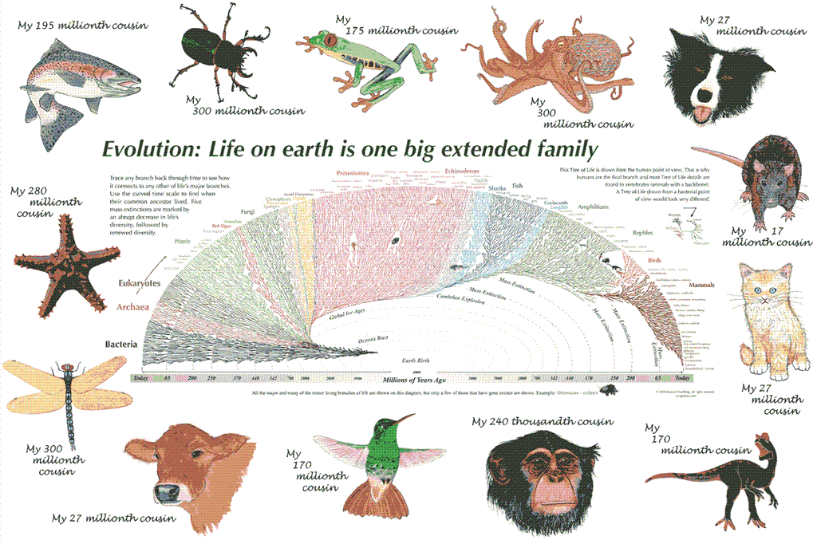
Common Ancestry Explored
Notes:
Here is a diagram of the “tree of life” with various organisms and their relatedness to humans. This beautiful tree of life can be found at https://www.evogeneao.com/. Just click on the link below the image. Students can interact with the image above and research their relatedness with the other organisms the family tree.

Slide 6
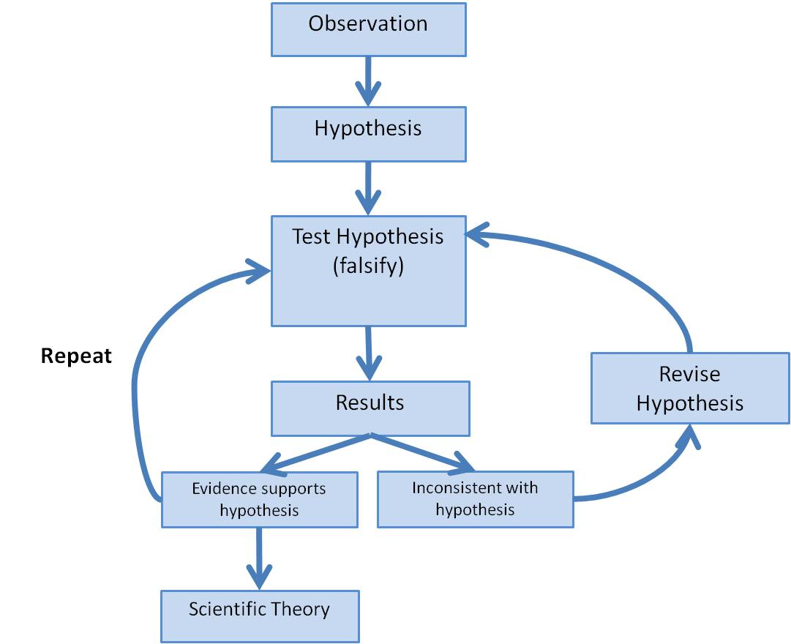
In Science, the word “Theory” is a BIG DEAL!
A theory is a well-substantiated, supported,
and documented explanation for our observations.
A theory is NOT a hunch NOR does it become a law.
Here's a nice explanation:
Notes:
A theory in science is a BIG DEAL! A theory is the scientific explanation for what we see (observations), an explanation that has been tested and overwhelmingly supported by evidence and therefore the scientific community. In science the expression “it’s just a theory” is just NOT applicable. A quick assessment can be carried out with this slide. Ask students to write the words: fact, hypothesis, law, theory in order of

Slide 7
Standard II: Evidence for Evolution comes from different sources and various disciplines:
Fossils
Biogeography
The Law of Superposition
Artificial Selection
Vestigial Structures: The evolutionary legacy we carry within our own bodies
Similarities: Comparative Anatomy
Overwhelming Genetic Evidence (not available in Darwin’s time)
Notes:
Evidence points to the validity of the theory of evolution. The more we know and discover through new technologies only substantiates it more. For this slide, it’s best to not reveal each evidence all at once. Ask students for possible lines of evidence. Hand out stickers or other small items for correct answers. Students can be divided into groups to research each line of evidence and share their findings in a number of ways, such as think, pair, share.

Slide 8
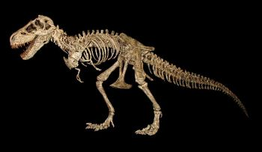
Evidence for Evolution 1. Fossils: Traces of long-dead organisms There are different types of fossils here are just a few.
Types of Fossils
A body fossil is the actual remains of the organism. The most common body fossils found are from the hard parts of the body, including bones, claws and teeth.
Notes:
Students can be divided into groups to research different types of fossils (see slide number 13 for an excellent resource). Students can also create fossil casts and molds using clay and any objects chosen by the teacher. Sample student discussion: What we can learn from fossils?

Slide 9
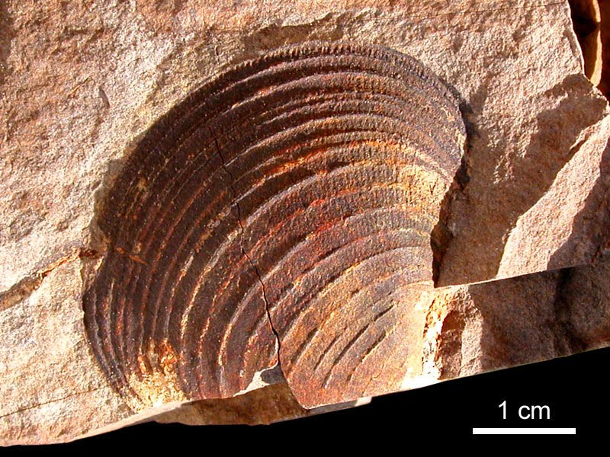
Types of Fossils
A fossil mold is formed by the impression left in rock by the remains of an organism.
Notes:
Casts and molds can be confusing for students. Which is which? Students can discover the difference using clay and objects chosen by the teacher. Here is a great lesson plan from the National Parks Service:
https://www.nps.gov/brca/learn/education/paleoact4.htm

Slide 10
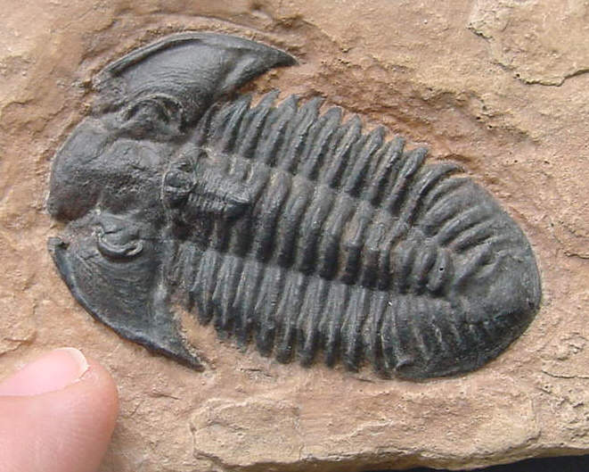
Types of Fossils
A cast fossil occurs when the mold is filled in by precipitating minerals.

Slide 11
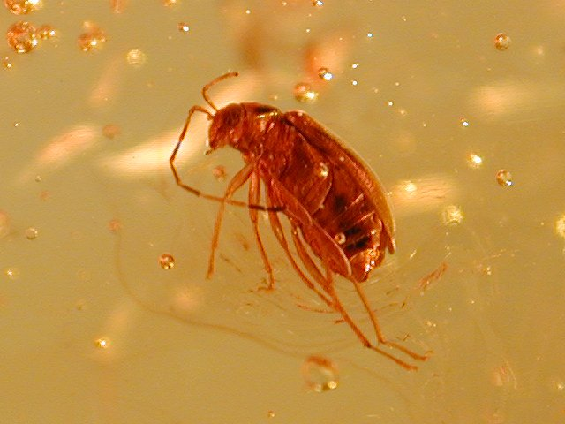
Types of Fossils
Amber: fossilized tree resin that can contain organisms

Slide 12
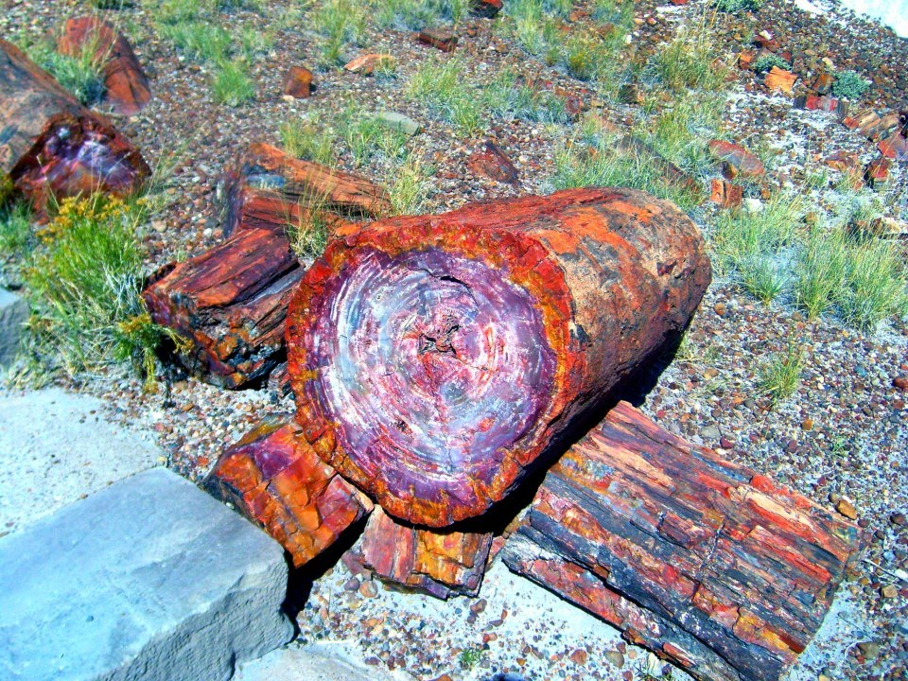
Types of Fossils
Petrified wood forms when plant material is buried by sediment and protected from decay by oxygen and organisms. Then, groundwater rich in dissolved solids flows through the sediment replacing the original plant material with inorganic material.

Slide 13
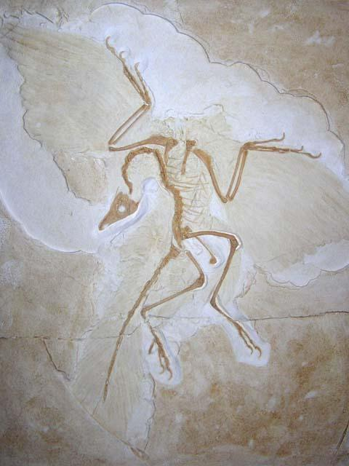
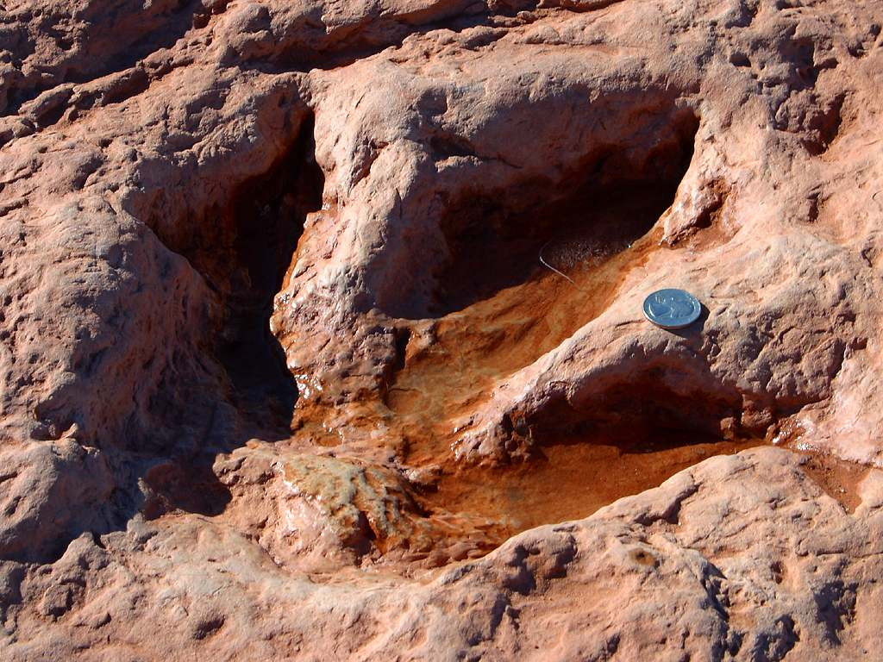
To learn more about the many different types of fossils, check out: The National Center for Science Education's Article on the subject
Notes:
Click on the link above for more information on fossils.

Slide 14
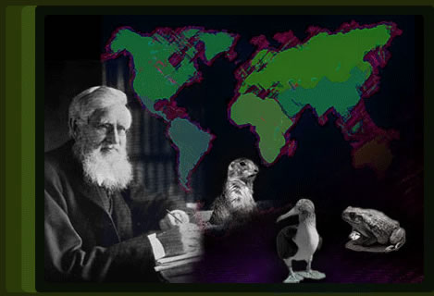
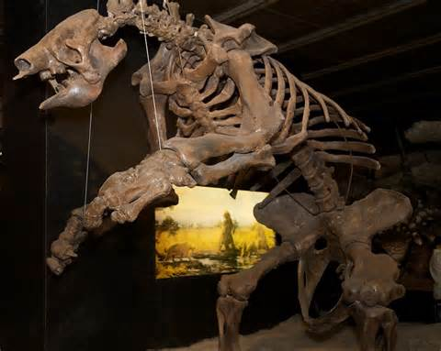
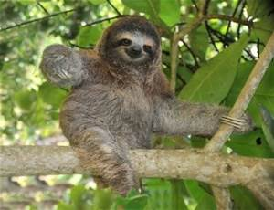
2. Biogeography: the study of the geographical distribution of fossils.
Evidence for Evolution
For example, in the Origin of Species, Darwin pointed out that fossils of giant armadillos and ground sloths are found only in the Americas, not in the Old World or Australia.
He thought that it was probably not a coincidence that modern-day armadillos and tree sloths are only found naturally in the Americas as well.
More here!
Notes:
See the link above for more information on Alfred Wallace’s (a contemporary to Darwin) work on biogeography. The link leads to a page in Cal Berkeley’s excellent website, Understanding Evolution.

Slide 15
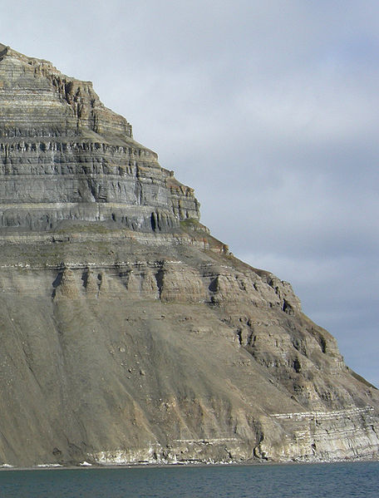
3. The Law of Superposition
Evidence for Evolution
Successive layers of rock or soil were deposited on top of one another by wind or water
The lowest layer (stratum) will be the oldest.
Relative age: a given fossil is younger or older than what is below or above it
Absolute age: actual age based on radioactive dating of sediment around fossil
The fossil record shows five mass extinctions in Earth history

Slide 16
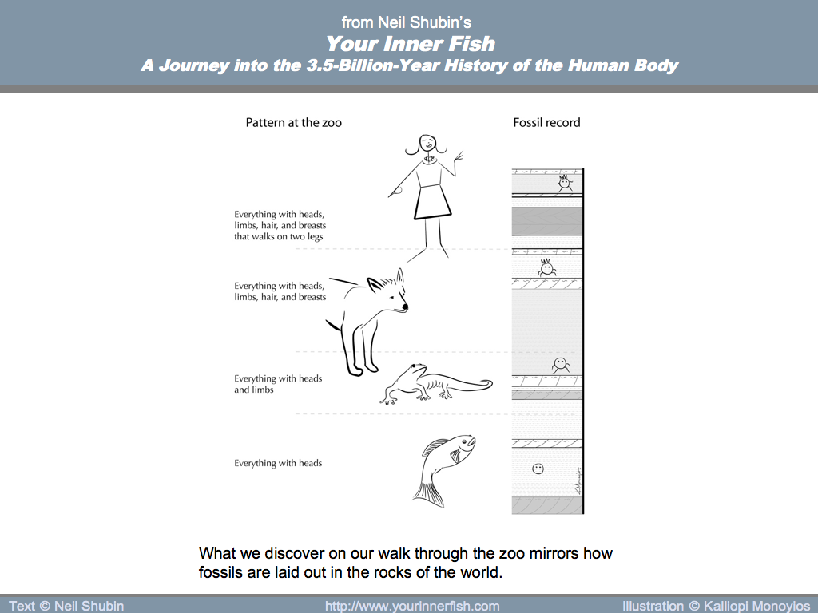
3. The Law of Superposition
The oldest rock (lowest)
contains the oldest organisms.
Notes:
Notice how organisms became more and more complex as time passed. This slide is from Neil Shubin’s webpage at the University of Chicago (http://tiktaalik.uchicago.edu/).

Slide 17
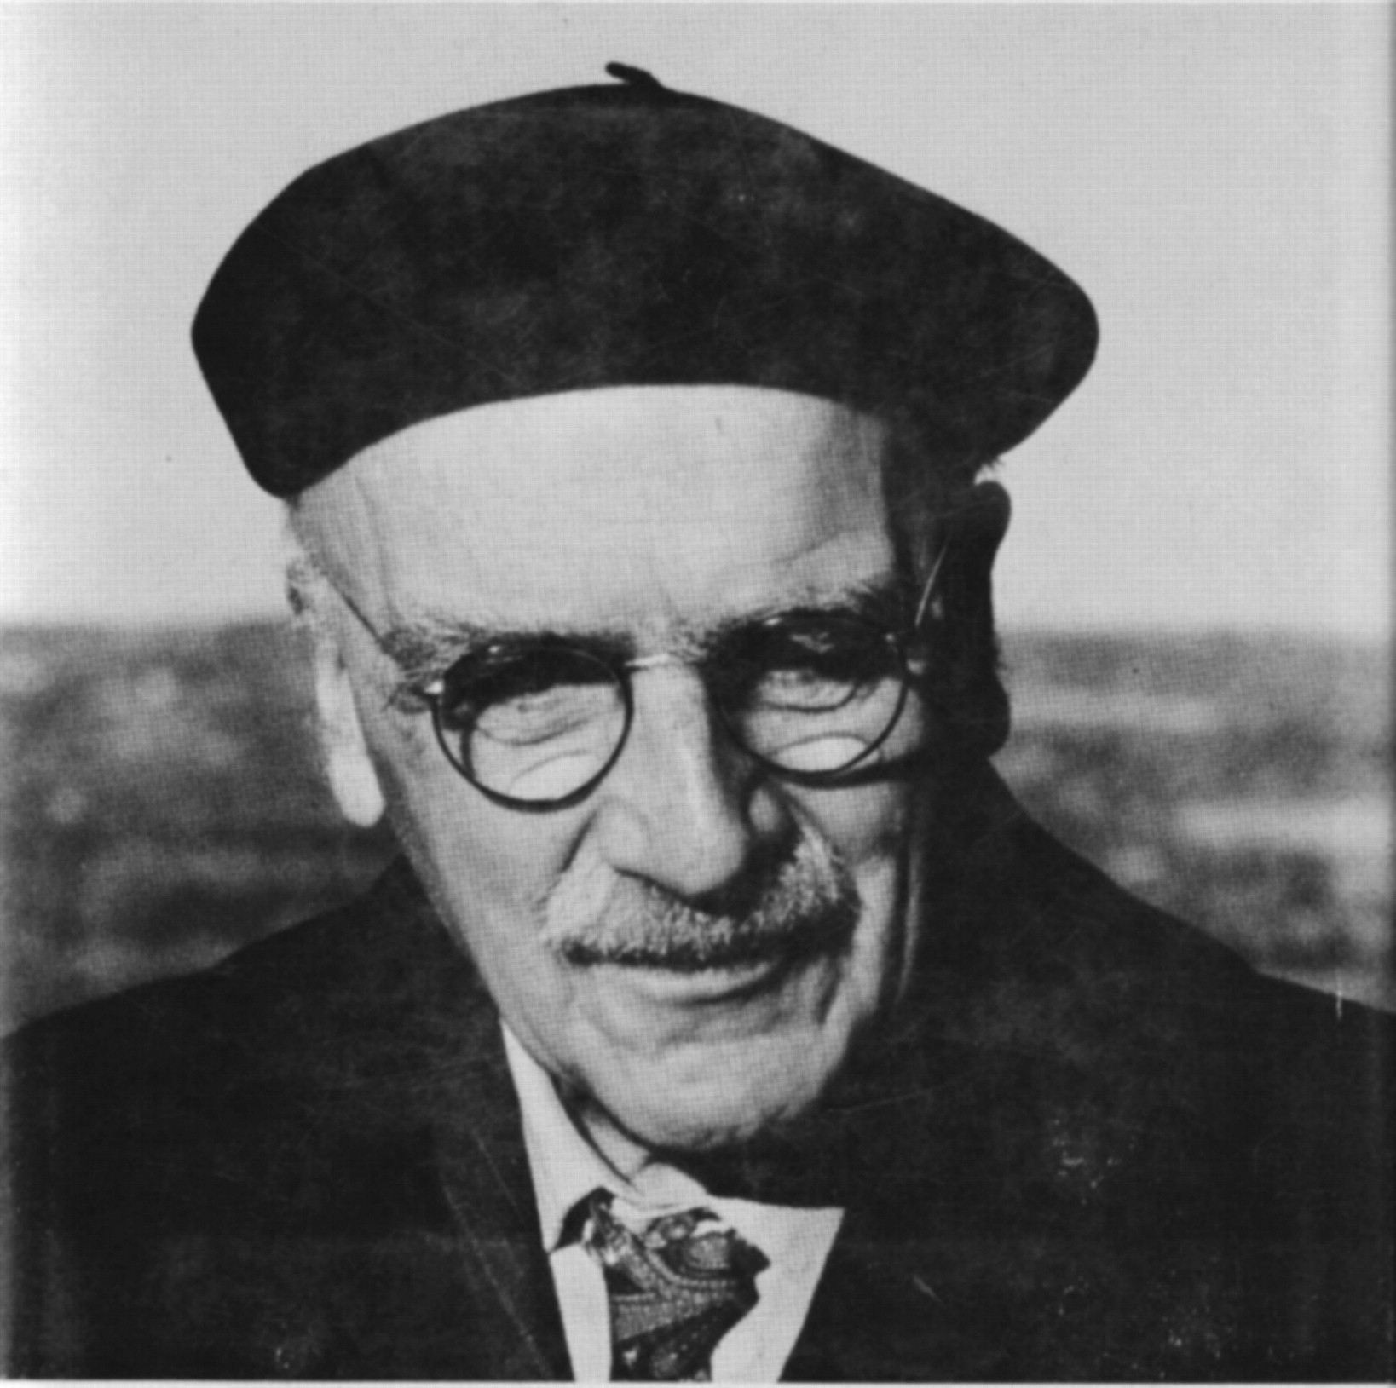
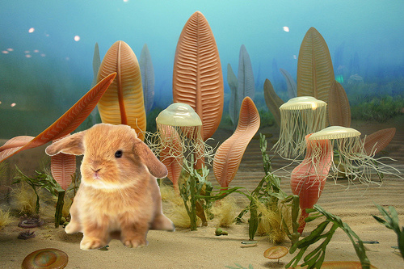
What would make you change your mind about Evolution?
The famous biologist, J.B.S. Haldane, answered, “Find me a rabbit fossil in Pre-Cambrian Rock.”
(nobody has!)
Notes:
There has been NO substantial discovery that disrupts the evidence for the chronological pattern of descent observed in Earth’s life. Life forms have gone from simple to more complex.

Slide 18
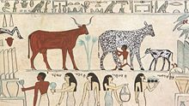
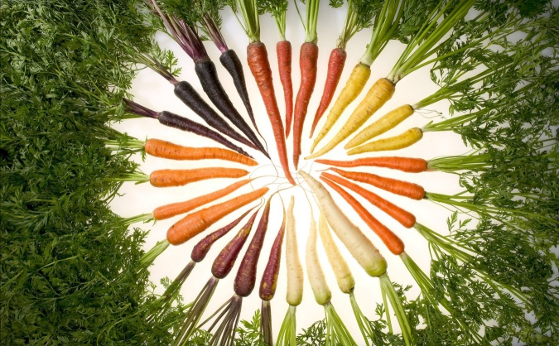
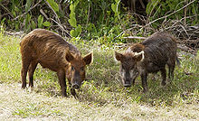

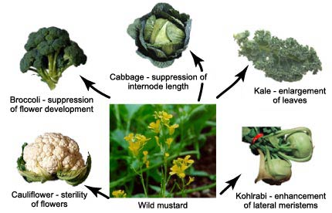
4. Artificial Selection
Evidence for Evolution
Darwin noticed how farmers and breeders allowed only the plants and animals with desirable characteristics to reproduce, causing the evolution of farm stock. He used this as evidence in Origin of Species.
Cows being milked in
ancient Egypt
These pics both show the same animal,
feral vs. domestic pigs.
Notes:
Even carrots have been bred to be orange…. They used to be white or purple!

Slide 19
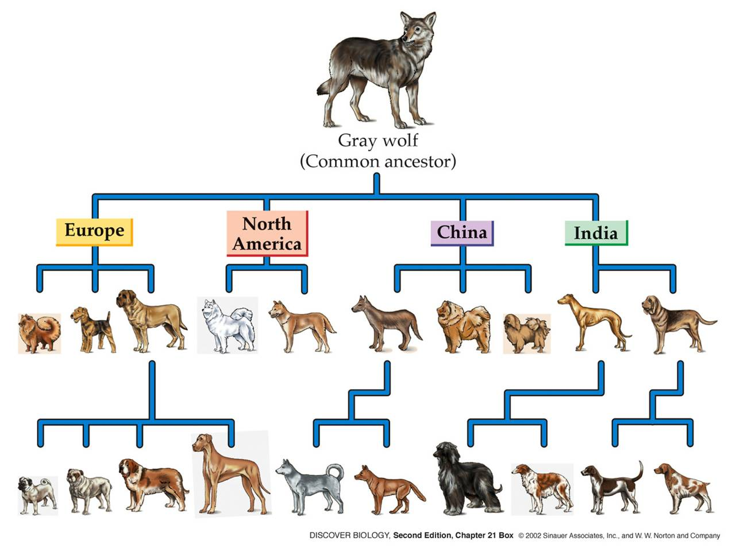
A Great Example of Artificial Selection
“Artificial selection provides a model that helps us understand natural selection.
It is a small step to envision natural conditions acting selectively on populations
and causing natural changes.”
From www.evolution.berkeley.edu
Notes:
So many variations, from a single common ancestor, selected this time by humans for human needs.
Additional Activity:
The link below takes you to a photo of the skulls of three different dog species. It is a beautiful set of skulls produced by BoneClones. Without telling the students that these three skulls belong to the same species, ask them what they think they are. The teacher can demonstrate how humans have artificially selected for different dog breeds over time.
https://boneclones.com/product/domestic-dog-comparison-economy-skull-set-COMP-DOMESTIC-DOG

Slide 20
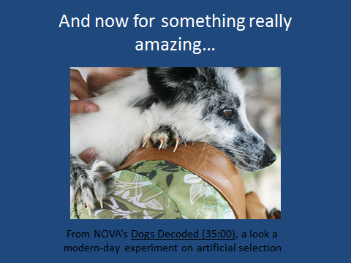
Notes:
This amazing video on the domestication of Siberian foxes can be found on Vimeo at https://vimeo.com/19472436. Scroll time stamp 36:20.

Slide 21
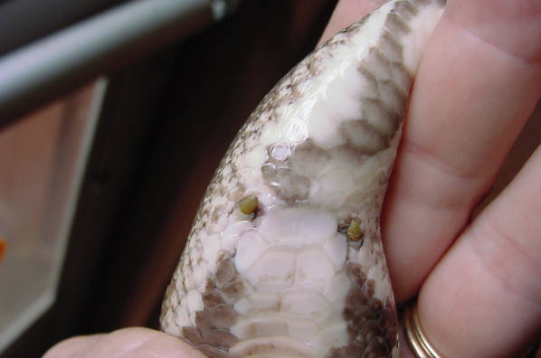
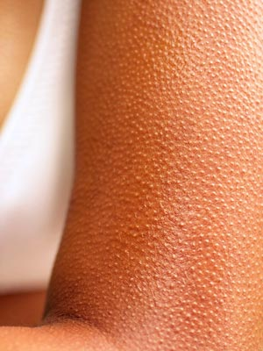
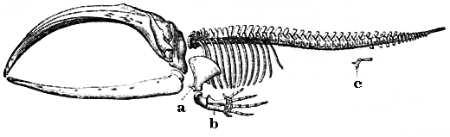
Evidence for Evolution
5. VESTIGIAL STRUCTURES are features that were adaptations for an organism’s ancestor but have evolved to no longer perform their original function due to a change in the organism’s environment.
Vestigial structures in humans
Anal spurs on a ball python
Goose bumps
Goose bumps
How did whales evolve?
C= hind legs on whale skeleton
Notes:
21
These structures no longer serve a purpose and are remnants from the past, evidence of common ancestry with other organisms. The first link is a brief look at some of the vestigial structures in humans (highly recommend!!). The link to whale evolution shows how whales evolved over millions of years from a land mammal. Finding a whale with hind leg bones was a fantastic discovery! There are several videos on this PBS webpage, go to the one with the killer whale titled, “How do we know evolution happens?”

Slide 22
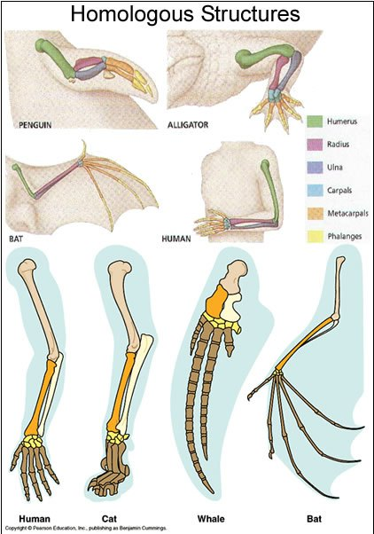
Evidence for Evolution
6. Similarities among related organisms:
Comparative Anatomy: The study of Homologous structures (ex. forearms) features in different species that are similar because those species share a common ancestor.
Notes:
All these organisms have similar structures! Look how similar the bones are. This is evidence showing how those organisms share a “recent” common ancestor. An excellent activity for this line of evidence is an owl pellet dissection. First, students can be taught to identify the main bones of the human skeleton. This is followed by an owl pellet dissection. Students will be amazed that they can identify the major bones of the small prey animals eaten by the owl using the same landmarks/features they studied in the human skeleton.

Slide 23
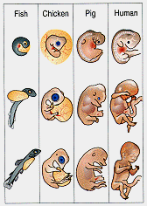




Embryonic development is also strikingly similar among related organisms.
Comparative Embryology:
Notes:
TIES Teacher Corps member Rebecca Brewer has shared an excellent hands-on inquiry activity for this line of evidence. This NOVA Activity can be found under “Most Popular Workshop Activities” at www.tieseducation.org.
As NOVA Embryo Activity: Timing is Everything
Answer key:
Fish 8, 1, 14 Chick 2, 7, 9 Pig 4, 15, 13 Calf 10, 6, 12 Human 3, 11, 5

Slide 24
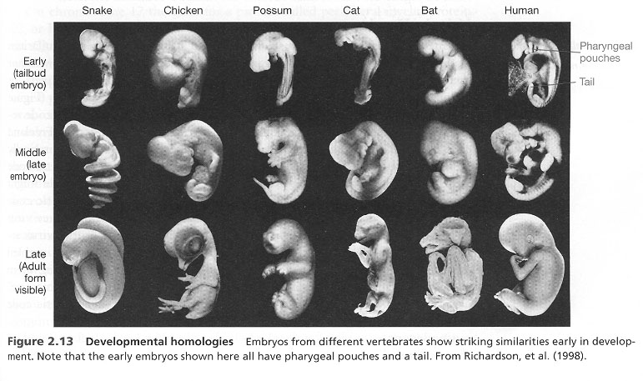
Notes:
Here is a more realistic view from http://faculty.ycp.edu/~kkleiner/EvolBio/EvolBioImages/EvidenceforEvol/Developmentalhomologies.jpg

Slide 25
7. The latest overwhelming evidence for evolution comes from molecular biology
Molecular Biology: is the strongest evidence for evolution. Not even known in Darwin’s time, it involves comparing the DNA of different species to determine their relatedness.
Just like our forelimbs or embryos are similar, so are our genes!
Genes are also homologous structures.
Notes:
Humans have just recently been able to see DNA “up close” and read its code. The Human Genome Project enabled us to understand where individual genes are on human DNA as of the year 2000. Since then we have been able to compare human DNA to other organisms’ DNA and the evidence shows what Darwin had said…. All living things share commonalities pointing to the tree of life and the evolution of species.

Slide 26
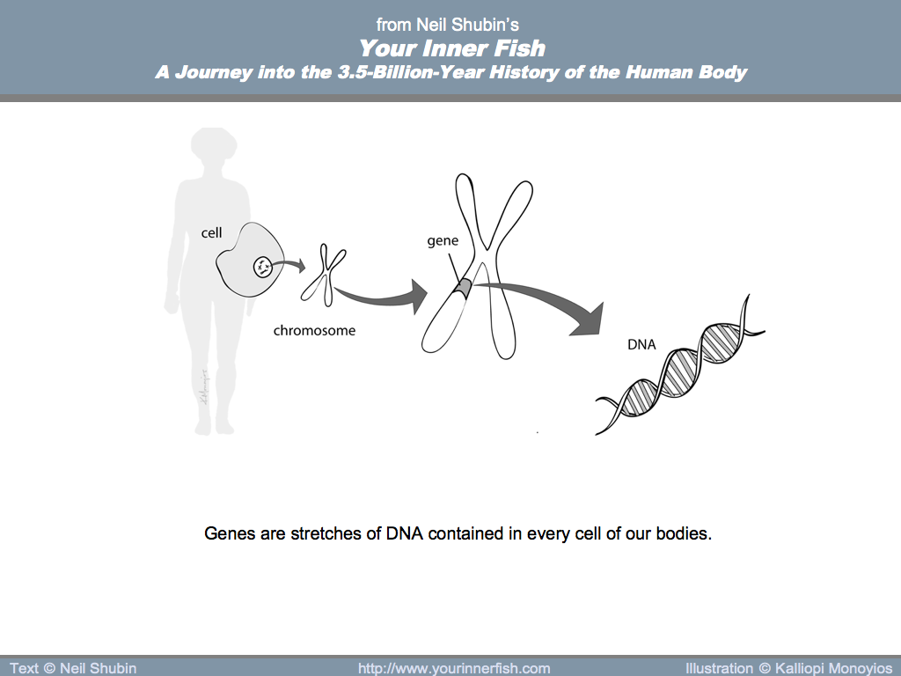
So What is a Gene?
Journey into DNA
Notes:
This slide comes from Neil Shubin’s webpage at the University of Chicago (http://tiktaalik.uchicago.edu/). Many more slides can be found for free in the educational section of his website (Resources and References). See link for an interactive view to how chromosomes contain genes that are in fact made of DNA.

Slide 27
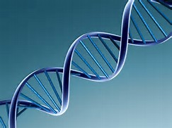
And what is DNA?
The function of DNA is to store and transmit the genetic information that tells cells which proteins to make and when to make them.
Notes:
DNA are molecules passed down from generation to generation that are the instructions for each organism.

Slide 28
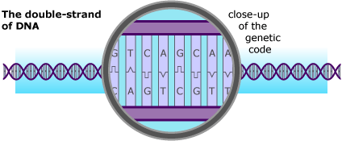
Does our DNA look like the DNA of other species?
Let's compare our DNA to our closest cousins
Notes:
Link shows just how similar human DNA is to chimpanzees, narrated by Richard Dawkins.

Slide 29
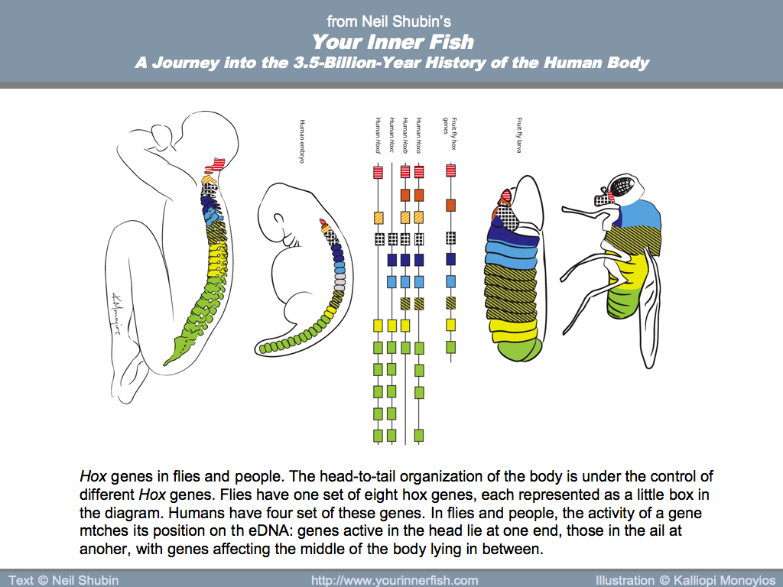
Hox Genes are similar in all animals
Hox genes in flies and people. The head-to-tail organization of the body is under the control of
different Hox genes. Flies have one set of eight hox genes, each represented as a little box in
The diagram. Humans have four sets of these gens. In flies and people, the activity of a gene
matches its position on the DNA: genes active in the head lie at one end, those in the tail at
another, with genes affecting the middle of the body lying in between.
Notes:
Hox genes are very important genes in establishing body structure. This slide also comes from Neil Shubin’s webpage at the University of Chicago (http://tiktaalik.uchicago.edu/).

Slide 30
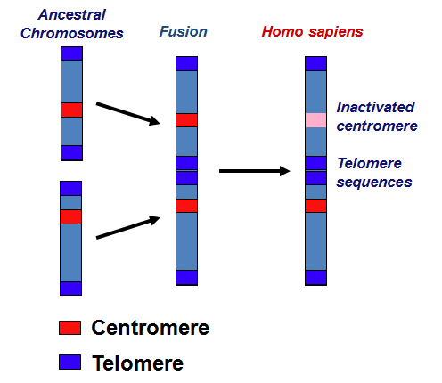
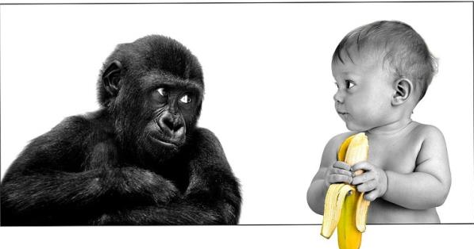
More examples of how genetics has informed evolutionary biology:
Kenneth Miller explains human chromosome #2
Richard Dawkins compares human and chimp DNA
Notes:
Human chromosome #2 matches up with chromosomes 12 and 13 of the chimpanzee, gorilla, and orangutan genomes. It appears that at some point after our species broke away from the other three, chromosomes 12 and 13 connected together. This is why humans have 46 chromosomes and the other apes have 48 chromosomes. Kenneth Miller does an excellent job of explaining this. Richard Dawkins shows the similarities between chimp and human DNA. This might be a good moment to tell students that your religious belief should not affect your acceptance of evolution. “Dr. Miller is Catholic, Dr. Dawkins is a non-believer. If you were lucky enough to have one of these two scientists teach you evolution, there should be NO difference in the content being taught.”

Slide 31
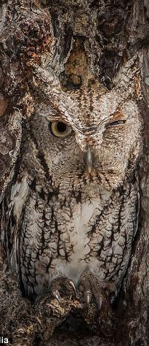
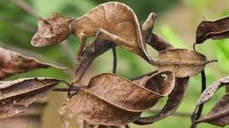
Standard III:
Natural Selection is a primary mechanism leading to change over time in organisms. It is the driving force behind evolution.
An example of natural selection:
The Evolution of Bacteria on a “Mega-Plate” Petri Dish
What is natural selection? Stated Clearly Video
Notes:
There are two excellent links on this slide. Check them out!

Slide 32
For Natural Selection to occur, 4 conditions must be met:
Traits in a population of organisms exhibit variation.
In any given population, not all individuals survive to reproduce.
Survival is NOT random. Survivors must have an advantage over those that don’t survive. A favorable trait gives the organisms an adaptive advantage.
The survivor’s advantageous traits MUST be heritable. High fitness means an organism’s ability to reproduce successfully.
See flowchart on next slide…..
Notes:
Please see our lab activity, This Lab is For the Birds. It is found under the Ready-to-Go Evolution Unit on the TIES Online Learning Page. A video of our TIES Director Bertha trying out the activity with her students can also be found on the TIES Online Learning Page as a guide for new teachers. This activity works well to cover this topic. Finally, HHMI BioInteractive has a beautiful video about the scientists and the finches who inspired this hands-on, inquiry-based activity. The video can be found here:
http://www.hhmi.org/biointeractive/origin-species-beak-finch
Presenting students with modern examples of natural selection is helpful. For example, many flea-killing medicines for dogs no longer work effectively. Show the students a box of Advantage Flea Killer and ask why it no longer works on our pets.

Slide 33
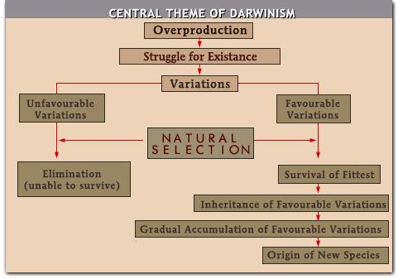
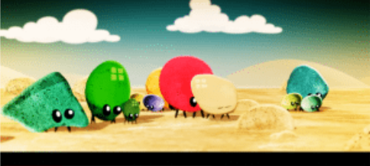
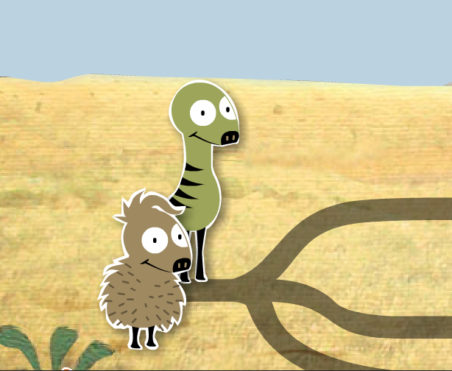
Let's play a game, The TIES Time Machine!
And watch a
Sweet little natural selection
story in pictures!
Notes:
Please try the game and show the video linked to the bottom!!! It is one of the best videos on natural selection I have ever seen! Perhaps the best video in this presentation. The game will engage your students, guaranteed.

Slide 34
Some important vocabulary:
Population: A group of organisms all of the same species living in the same area.
Genotype: The actual set of genes (strips of DNA in the chromosomes) that an organism has inherited.
Phenotype: The outward, physical expression of those genes.
Mutation: A permanent change in the DNA of an organism. If it is passed on to the organism’s offspring, it may be harmful, harmless, or helpful for the offspring.
Notes:
Important vocabulary when studying genetics. Terms that describe key notions all closely related to Evolution.

Slide 35
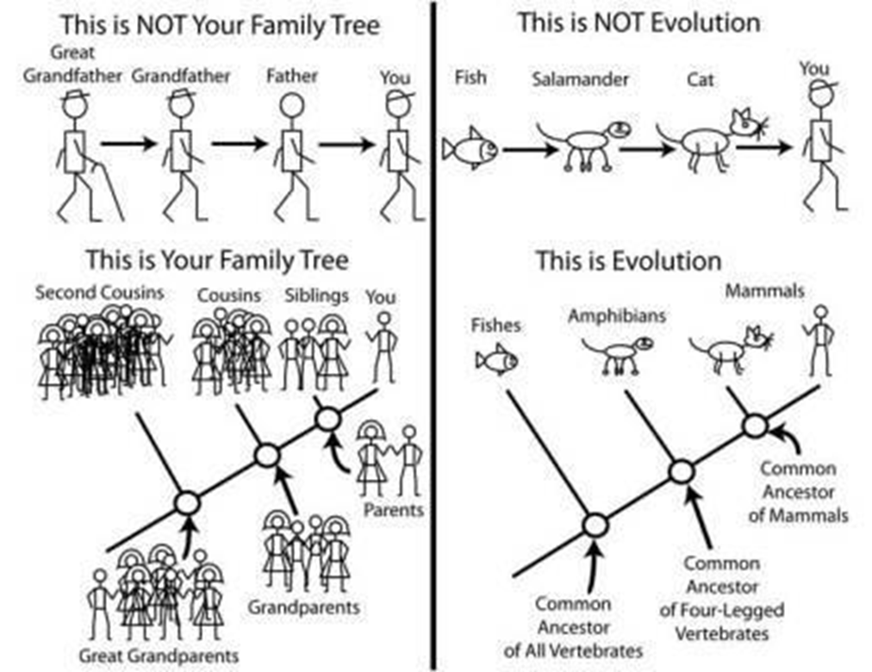
Misconceptions about Evolution
Amusing Link to Myths Here
Is nature always perfect? No, it's not. How about a giraffe dissection?
Notes:
The illustration on this page addresses the issue with erroneous, linear evolution. The tree of life is not linear. It branches off. The link above the title is a wonderful cartoon about common misconceptions. The second link discusses how the nerve that enervates our throat takes a very long route to get there from the brain. WARNING: There is a dead giraffe in this video which may upset some children. Please preview this one first.
Here’s a great way to introduce the giraffe dissection video:
The teacher should have a ball of yarn or string in his/her hands.
Ask 10-15 students to form a circle.
Hand a ball of yarn or string to one of the students (Student A).
Make sure student A keeps the loose end of the yarn in his/her hand at all times.
Ask another student to take the ball of yarn and hand it to any other student (Student B). As a result, students A and B will be connected with the yarn.
Pose the question, Do you think this is the most efficient way to connect two students in the circle with the yarn?
Take the yarn from the student B and go to 4-5 students, making sure each one holds the yarn before returning the ball of yarn to student B.
Repeat the question, Do you think this is the most efficient way to connect two students in the circle with the yarn?

Slide 36
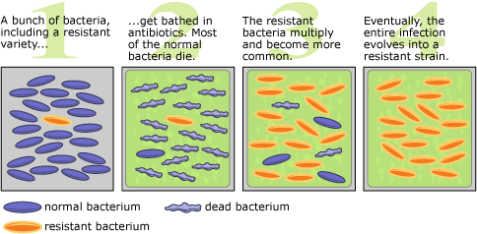
How does natural selection play a role in our own lives? Have you ever had strep throat? The Amoeba Sisters explain bacterial resistance.
Notes:
Antibiotics can actually select for a resistant variant of a bacteria, killing all its competition and allowing only the resistant strain to reproduce. You can click on above link for an animation showing how this is having an effect on human health.

Slide 37
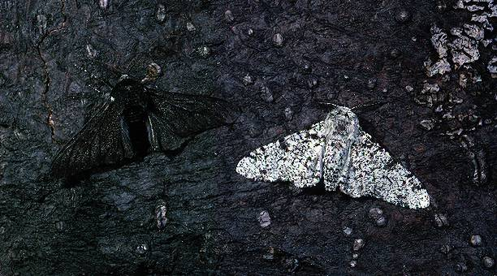
Check out the TIES Website (www.tieseducation.org)
Find the perfect hands-on or online resource for your lessons.
Notes:
The TIES Online Learning Page has tabs with various classroom resources, including PowerPoints, exams, labs, and online games. The page also includes a video of the first TIES workshop, videos of students completing some of our most popular labs, and links to other valuable educational webpages.

