Slide 1
Let’s Play…Spot the Misconception!
Evolution Edition

Slide 2
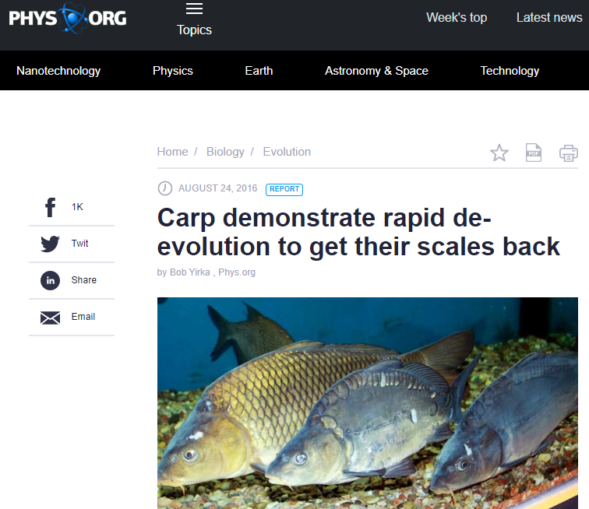
Misconception #1

Slide 3
Misconception #1 = De-evolution
There is no such thing as De-evolution, Re-evolution, Reverse evolution, or Forward or Backward evolution.
There is only evolution and how populations respond to unique selective pressures in their ecosystems.
https://ncse.ngo/misconception-monday-myth-de-evolution-part-2

Slide 4
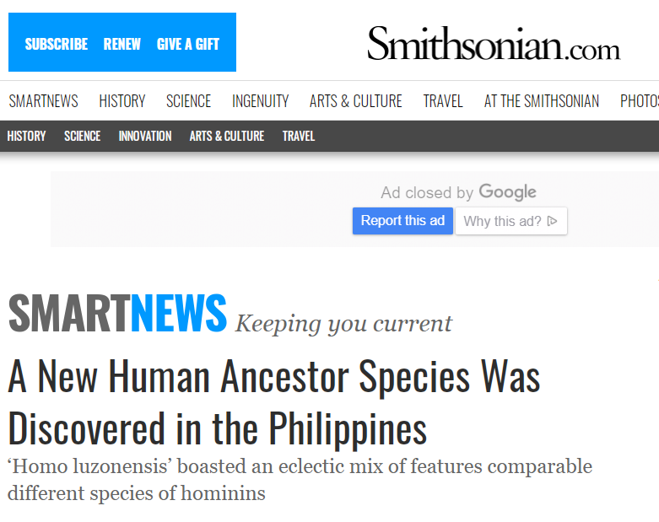
Misconception #2

Slide 5
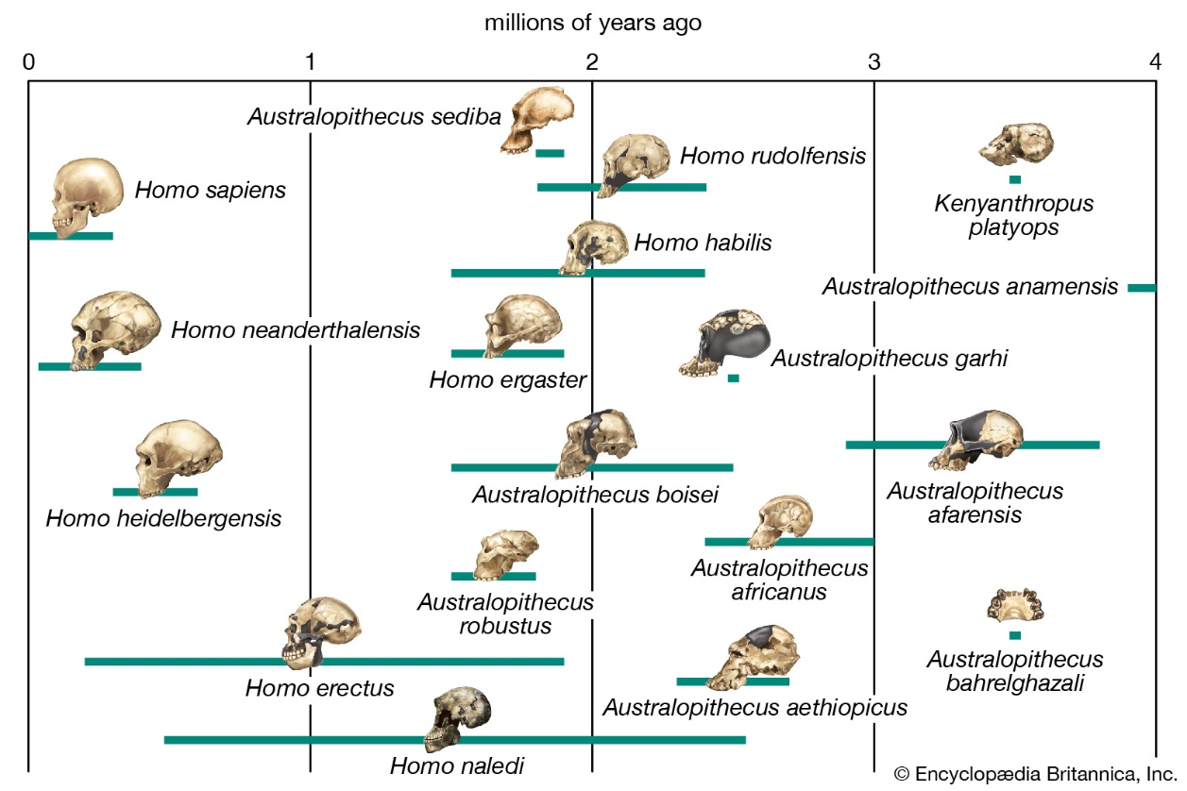
Misconception #2 = Every hominid fossil found was a direct ancestor of modern humans
Human evolution (like all evolution) is branched and complicated, not simple and linear.
Multiple human species existed at the
same time as Homo sapiens.

Slide 6
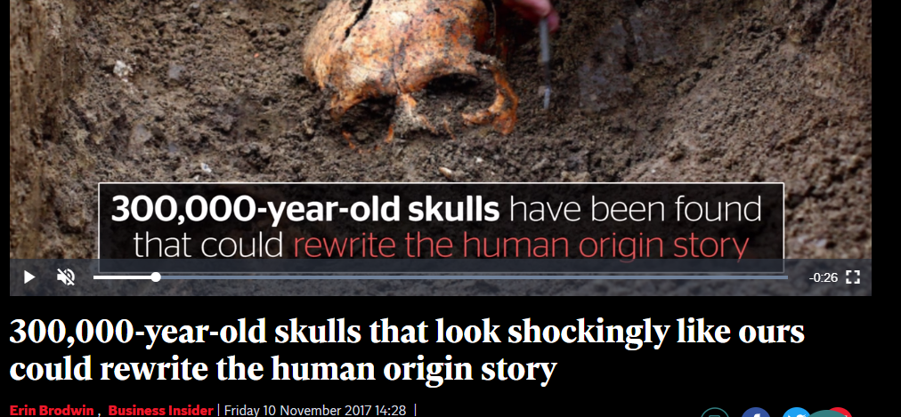
Misconception #3

Slide 7
Misconception #3 = Evolution is a “Theory in Crisis”
Evolution is often presented as a “Theory in crisis” in which one single discovery will cause scientists to throw out everything that we know about evolution and completely rewrite textbooks.
This is a misrepresentation of how the process of science actually works.
https://evolution.berkeley.edu/evolibrary/news/070901_headlines

Slide 8
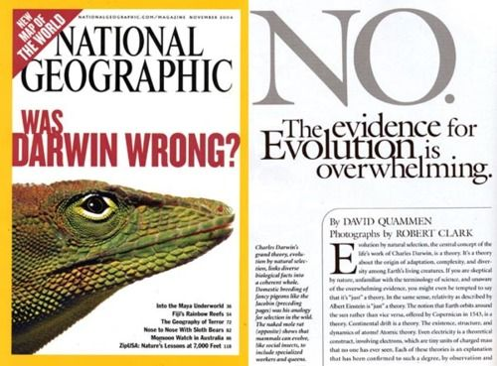
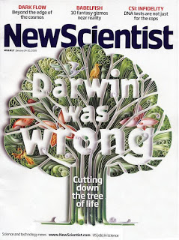
Extension of Misconception #3

Slide 9
Extension of Misconception #3.
Many times, sensationalized headlines such as “Darwin was wrong” or “Everything you thought you knew was a LIE” are used by publishers to hook people in to picking up their magazines or used online as #ClickBait.
These headlines can perpetuate the misconception that evolution is a theory in crisis because most people won’t actually get past the headline. If they would read the article after the headline, they would see that these things are over-exaggerations and what we knew before wasn’t WRONG, it was just oversimplified or incomplete.

Slide 10
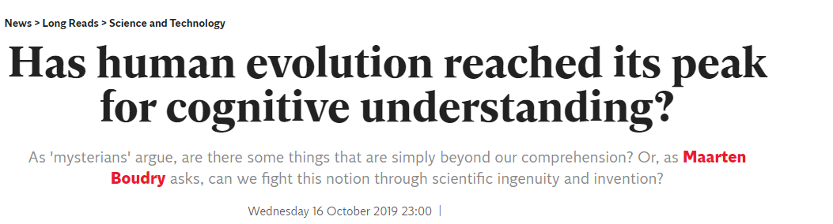
Misconception #4 and Misconception #5

Slide 11
Misconception #4 = Evolution has a goal in mind that it is working to achieve.
Although many headlines personify evolution and present it as a cognizant entity that is progressively trying to improve species, that is not actually how evolution works.
Evolution doesn’t have a brain or foresight.
Misconception #5 = Evolution can stop once it is “finished”.
Evolution does not have an “end goal”.
Evolution is constantly happening and species never stop changing.

Slide 12
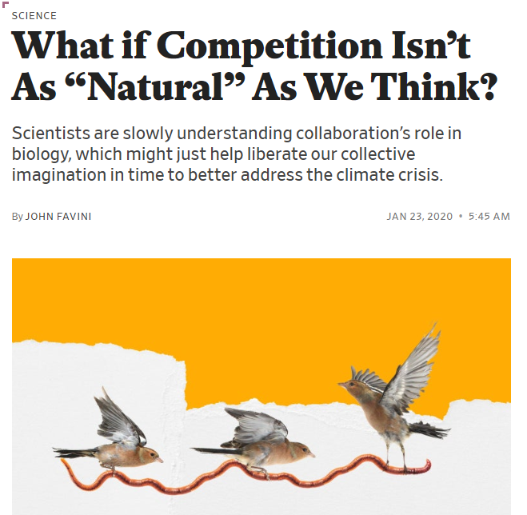
Misconception #6

Slide 13
Misconception #6 = Natural Selection will always favor selfish individuals and behaviors.
“Survival of the Fittest” has become synonymous with strong, selfish behavior, but natural selection can also explain cooperation and altruism.
If cooperation increases the overall fitness of a population, it will be selected for over other populations that do not cooperate and have lower fitness.
See “Evolutionary Game Theory”

Slide 14
Resources to teach about Misconceptions:
https://evolution.berkeley.edu/evolibrary/misconceptions_faq.php
http://pages.nbb.cornell.edu/neurobio/websterlab/10%20Misunderstandings%20-%20SHORT.pdf

